Slide 1
Selection and Iterative Statements in C

Slide 2
Browsing Problem
Given the number of hours and minutes browsed, write a program to calculate bill for Internet Browsing in a browsing center. The conditions are given below.
(a) 1 Hour Rs.50
(b) 1 minute Re. 1
(c) Rs. 200 for five hours
Boundary condition: User can only browse for a maximum of 7 hours
Check boundary conditions

Slide 3
Browsing Program
Input | Processing | Output
Number of hours and minutes browsed | Check number of hours browsed, if it is greater than 5 then add Rs 200 to amount for five hours and subtract 5 from hours Add Rs for each hour and Re 1 for each minute Basic process involved: Multiplication and addition | Amount to be paid

Slide 4
Pseudocode
READ hours and minutes
SET amount = 0
IF hours >=5 then
CALCULATE amount as amount + 200
COMPUTE hours as hours – 5
END IF
COMPUTE amount as amount + hours * 50
COMPUTE amount as amount + minutes * 1
PRINT amount

Slide 5
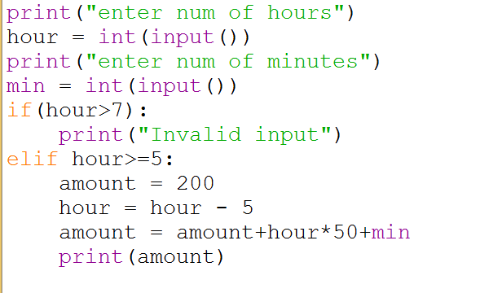
Browsing Program

Slide 6
Already Know
To read values from user
Write arithmetic expressions in C
Print values in a formatted way

Slide 7
Yet to learn
Check a condition

Slide 8
Syntax of if Statement Two Alternatives
Form 1:
if ( condition )
statement _{T} ;
Eg:
if (x > 0.0)
pos_prod = pos_prod * x;
If condition evaluates to true (a nonzero value), then statement _{T} is executed; otherwise, statement _{T} is skipped.

Slide 9
Syntax of if Statement Two Alternatives
Form 2:
if ( condition )
statement _{T} ;
else
statement _{F} ;
If condition evaluates to true (a nonzero value), then statement _{T} is executed; otherwise, statement _{F} is executed

Slide 10
Example
if (x >= 0.0)
printf("positive\n");
else
printf("negative\n");

Slide 11
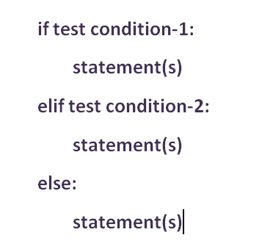
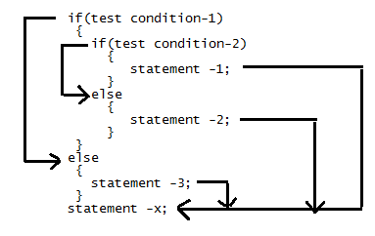
If Statement in Python and C

Slide 12
Compound Statements
Until now we have been using only sequential flow
A compound statement, written as a group of statements bracketed by { and } , is used to specify sequential flow.
{
statement 1 ;
statement 2 ;
...
statement n ;
}

Slide 13
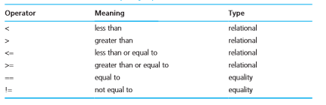
Relational and Equality Operators

Slide 14
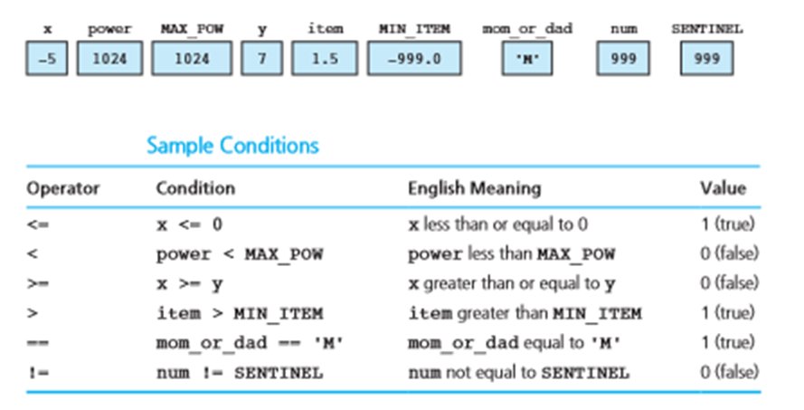
Examples
Memory with Values

Slide 15
Logical Operators
To form more complicated conditions or logical expressions
Three operators:
And (&&)
Or (||)
Not(!)

Slide 16
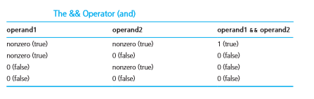
Logical And

Slide 17
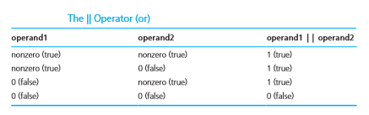
Logical Or

Slide 18
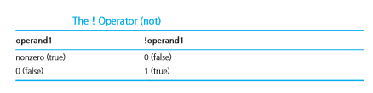
Logical Not

Slide 19
True/False Values
For numbers all values except 0 is true
For characters all values except ‘/0’ (Null Character) is true

Slide 20
Short Circuit Evaluation
Stopping evaluation of a logical expression as soon as its value can be determined is called short-circuit evaluation
Second part of ‘&&’ does not gets evaluated when first part is evaluated as False
Second part of ‘||’ does not gets evaluated when first part is evaluated as true

Slide 21
Short Circuit Evaluation
(num % div == 0) – Runtime error if div = 0
But prevented when written as
(div != 0 && (num % div == 0))

Slide 22
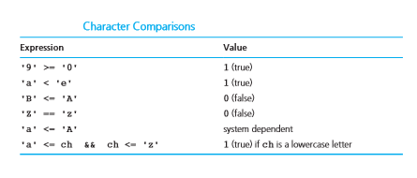
Comparing Characters
We can also compare characters in C using the relational and equality operators

Slide 23
Logical Assignment
even = (n % 2 == 0);
in_range = (n > -10 && n < 10);
is_letter = ('A' <= ch && ch <= 'Z') || ('a' <= ch && ch <= 'z');
Variable in_range gets 1 (true) if the value of n is between −10 and 10 excluding the endpoints;
is_letter gets 1 (true) if ch is an uppercase or a lowercase letter.

Slide 24
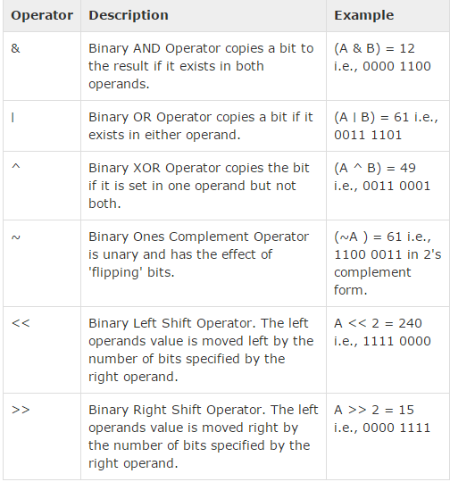
When 'A‘ = 60 and 'B' =13

Slide 25
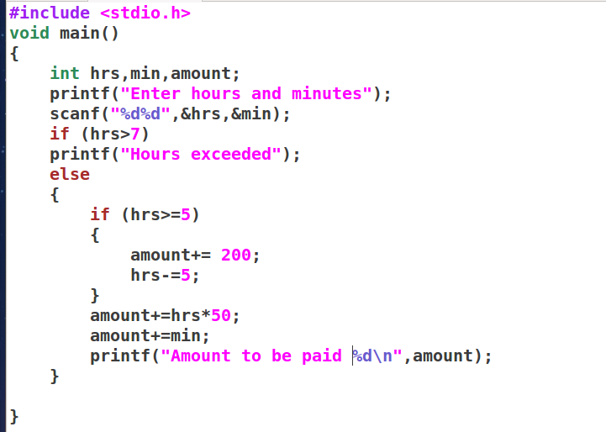

Slide 26
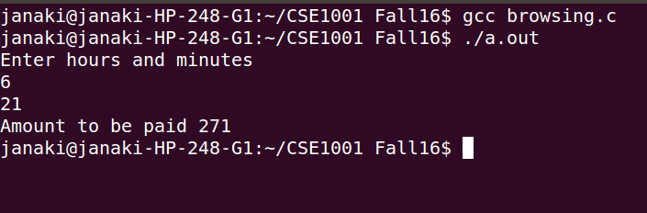

Slide 27
Example
/* increment num_pos, num_neg, or num_zero depending on x */
if (x > 0)
num_pos = num_pos + 1;
else if (x < 0)
num_neg = num_neg + 1;
else /* x equals 0 */
num_zero = num_zero + 1;

Slide 28
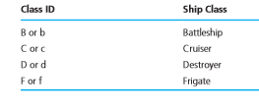
Class of the Ship
Each ship serial number begins with a letter indicating the class of the ship. Write a program that reads a ship’s first character of serial number and displays the class of the ship.

Slide 29
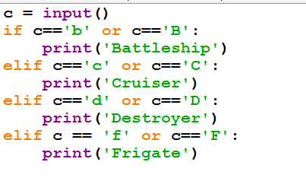

Slide 30
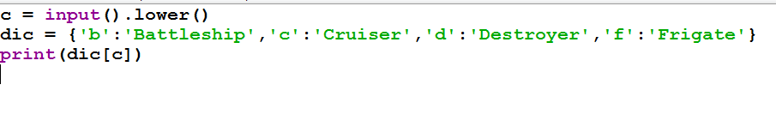

Slide 31
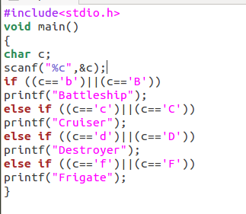
Nested if Statements

Slide 32
Switch Statement
Useful when the selection is based on the value of a single variable or of a simple expression (called the controlling expression)
Value of this expression may be of type int or char , but not of type double

Slide 33
Syntax of Switch Statement
switch ( controlling expression )
{
label set₁
statements₁
break;
label set_{n}
statements_{n}
break;
default:
statements_{d}
}

Slide 34
Syntax of Switch Statement
When a match between the value of the controlling expression and a case label value is found, the statements following the case label are executed until a break statement is encountered.
Then the rest of the switch statement is skipped.
If no case label value matches the controlling expression, the entire switch statement body is skipped unless it contains a default label.

Slide 35
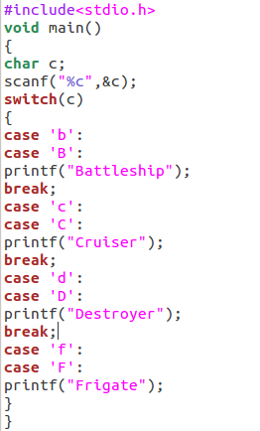

Slide 36
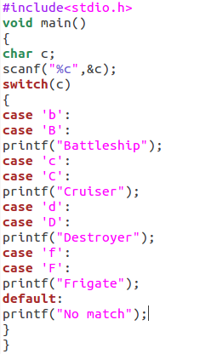
Output
BattleshipCruiserDestroyerFrigateNo match
When input is b

Slide 37
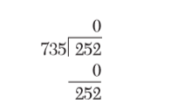
GCD of Two Numbers
The greatest common divisor (GCD) of two integers is the product of the integers’ common factors. Write a program that inputs two numbers and find their GCD by repeated division. For example, consider the numbers 252 and 735. find the remainder of one divided by the other.

Slide 38

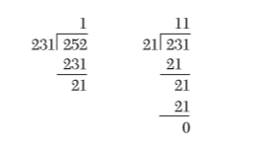
GCD of Two Numbers
Now we calculate the remainder of the old divisor divided by the remainder found
Repeat the process until remainder is zero
The Divisor when remainder is zero is the GCD
21 is the GCD

Slide 39
GCD problem
Input | Output | Logic Involved
Two numbers | GCD of the numbers | Euclidean algorithm, binary GCD algorithm, repeated division method

Slide 40
Algorithm to Find GCD
Step 1: Read the numbers from the user
Step 2: Let dividend = number1 and divisor = number2
Step 3: Repeat step 4 to step 6 while remainder not equal to zero
Step 4: remainder = number1 modulus number2
Step 5: dividend = divisor
Step 6: divisor = remainder
Step 7: GCD = divisor
Step 8: print GCD

Slide 41
Implementation
We have to learn how to repeat statements
In some cases the number of times to repeat a statement is known, in weather report example it is ten times we have to repeat some statements
In some other cases the conditions are not direct as a number but as a terminating condition that may be based on I/O. In our GCD problem, the statements are to be repeated till reminder becomes zero

Slide 42
While loop
To repeat a set of statements either while a condition is met or till a condition is met
while (loop control variable < final value) . . . Change value of loop control variable

Slide 43
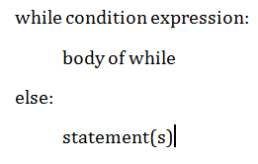
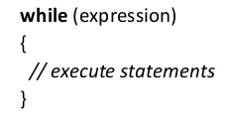
While Statement in Python and C

Slide 44
Syntax of a For loop
for (loop control variable initialization; loop terminating condition; loop control variable update)
All three components are optional
But semicolons are mandatory

Slide 45
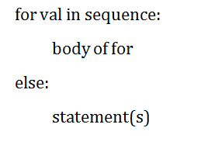
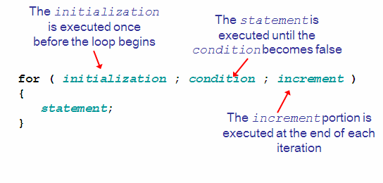
For Statement in Python and C

Slide 46
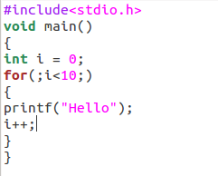

Slide 47
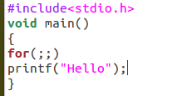

Slide 48
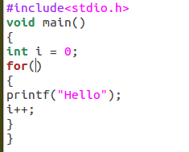

Slide 49
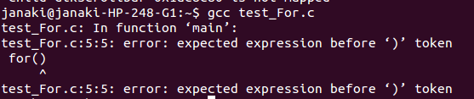

Slide 50
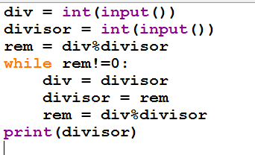
GCD Program Using While in Python

Slide 51
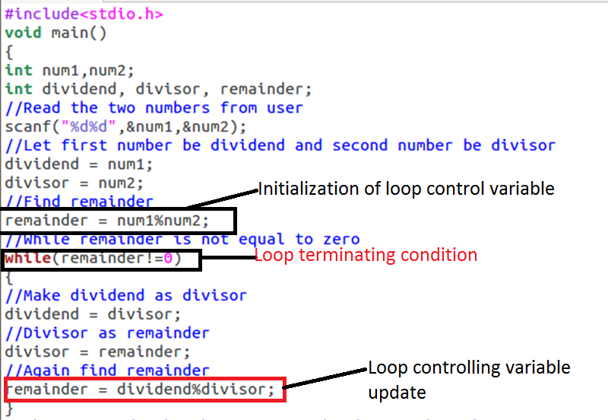
GCD Program Using While in C

Slide 52
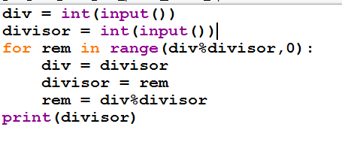
GCD Program Using For in Python

Slide 53
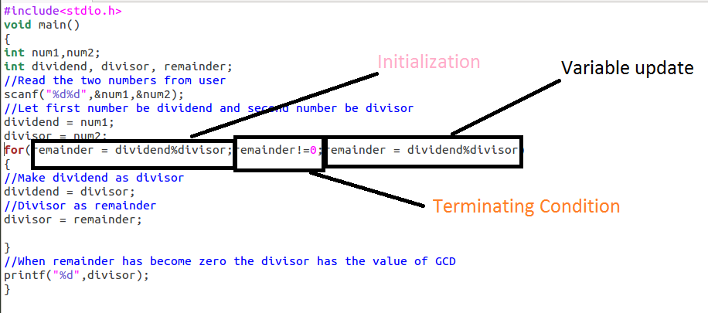
GCD Program Using For in C

Slide 54
Do while Loop
Similar to a while loop, except the fact that it is guaranteed to execute at least one time
Syntax :
do
{
statement(s);
} while( condition );
Condition is checked at the end of execution

Slide 55
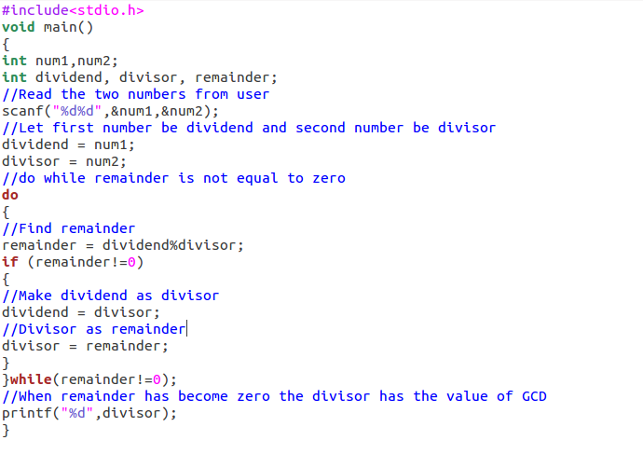
GCD Program Using Do While

Slide 56
Break and Continue Statements
Interrupt iterative flow of control in loops
Break causes a loop to end
Continue stops the current iteration and begin the next iteration

Slide 57
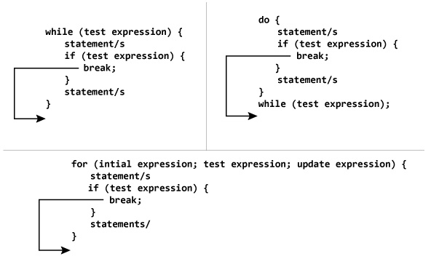

Slide 58
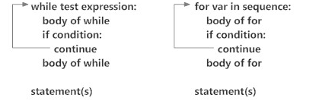

Slide 59
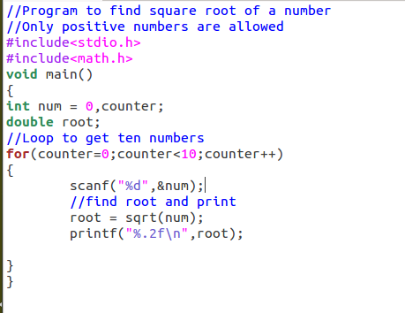

Slide 60
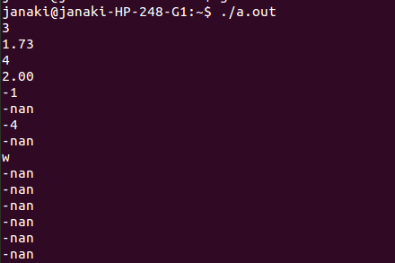

Slide 61
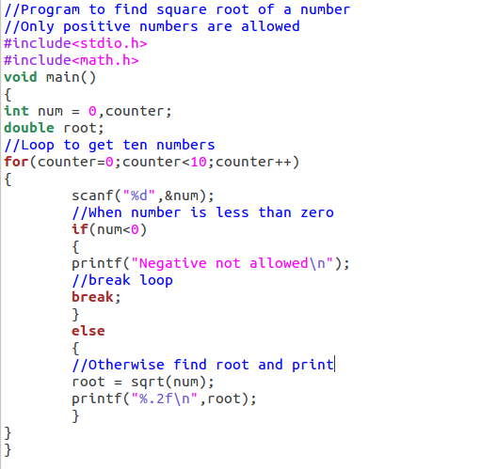

Slide 62
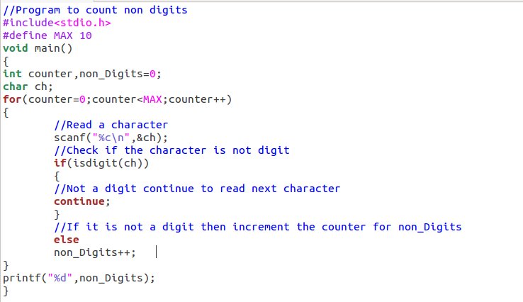

Slide 63
